Slide 1
A Simple Pipeline to Create OTU Table
Lei Yu

Slide 2
Outline
Introduction
Bioinformatics Pipeline
Statistical Results

Slide 3
Data Description
Sequences Data (22.8 GB):
18 Plots and 4 subplots in each plot + negative control ->73 samples
Forward and complement reverse for each sample
Environmental Data:
Soil Chemistry, Trees, Location
PC or Cluster?

Slide 4
HPCC
High-Performance Computing Center (Linux System)
ssh -x [account name]@cluster.hpcc.ucr.edu
Login through terminal (Mac and Linux)
Login through Cygwin (Windows)
Login through FTP (FileZilla)

Slide 5

GitHub and GitLab
https://github.com/YULEITSINGTAO/
https://yuleitsingtao.github.io/TNC_project/
Repository management services are vital aspects of successfully developing software, either individually or collaboratively.

Slide 6
Use the code source on GitHub
$ git clone [url]

Slide 7
Bioinformatics Pipeline
Raw Sequences Data
Quality of Sequences
Trim Sequences
Bad
Quality of trimmed Sequences
Usearch：
1.Merge
2.Filter
3.Uniques
4.otus
5.otutable
6.pred
7.normalize
Good

Slide 8
Run Programmes
Copy the pipeline
$ ssh -x [account name]@cluster.hpcc.ucr.edu
$ cd ~/shared
$ cp -a Lei_pipeline [your local directory]
2. Go to your local directory
$ cd [your local directory/Lei_pipeline]

Slide 9
3. Check files
$ ls
FastQC cutadapt raw_sequences_report Qiime2 data_processing trimmed_sequences Usearch_project input_raw_sequences trimmed_sequences_report
4. Upload your sequences into [raw_sequences_report]
I like using FileZilla
Notes: Blue color -> Folders Green color-> Programmes

Slide 10
5. Data processing
$ cd data_processing
$ ls
trim test_qc_input_raw_sequences
test_qc_trimmed_sequences
$ ./test_qc_input_raw_sequences
$ ./code_trimme
$ ./test_qc_trimmed_sequences
6. Go to check trimmed sequences
I like using FileZilla
$ cd
Notes: If the quality of trimmed sequences are not good, you want to change the parameters in trim

Slide 11
7. Run Usearch
$ cd Usearch_project
$ ls
combine_otu_reference.shell otus summary
filter otutable uniques.sh
make_database out unitITS.udb
merge pred usearch
normalize.sh run utax_reference_dataset_01.12.2017.fasta
$ ./run
Notes: You may want to use more CPUs, change the parameters in uniques.sh
Some parameters also need to change depend on trimmed sequences

Slide 12
8. See results in out
$ cd out
merged.fq otutable.txt reads_survey.txt filtered.fa otus.fa otutable_normalized.txt uniques.fa
9. Merge reads_survey.txt and otutable.txt
(This step can be finished in bash or any other languages you like)
$ cd ..
$ ./combine_otu_reference.shell

Slide 13
10. Merge otutable will be in out as well
$ cd out
$ combine merged.fq otutable.txt reads_survey.txt filtered.fa otus.fa otutable_normalized.txt uniques.fa
Finally, we get the otu table

Slide 14
Statistics Work
Language: R
There are 4235 outs
Abundance Curve
Alpha diversity and Beta diversity

Slide 15
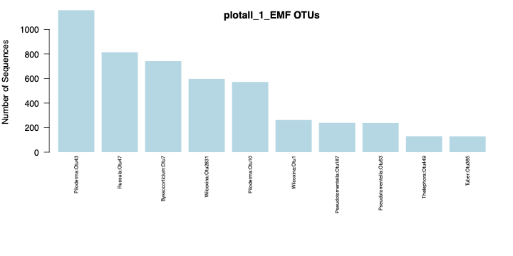
Abundance Curve

Slide 16
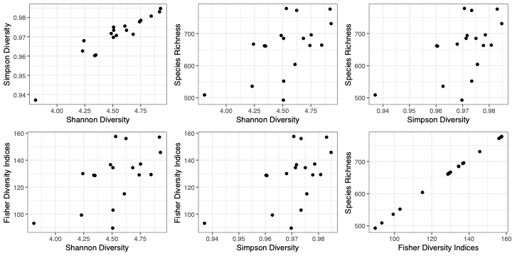
Alpha diversity

Slide 17
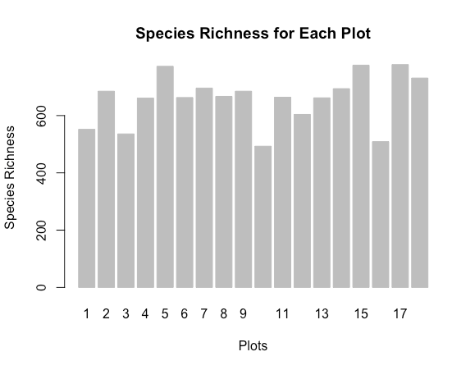
Species Richness
Plot 1, 3 10 and 16 show less species richness than others.
What factors influence the alpha diversity?

Slide 18
Environmental Data set
There are 226 features in the raw environmental data.
We clean the environmental data deleting the NA value and manual delete some useless features.
Then analysis the linear relationship between each features and delete the features which can be linear represented by others.

Slide 19
General Linear Regression
Based on general linear regression model, we find the 12 key features:
MG, CA, H, CEC, NO3_N, S, CC_Mult_FR, FRI, CEI, Precip_Yr, Water_Bal, CC_LIDAR.
Soil chemistry > Trees Environment.

Slide 20
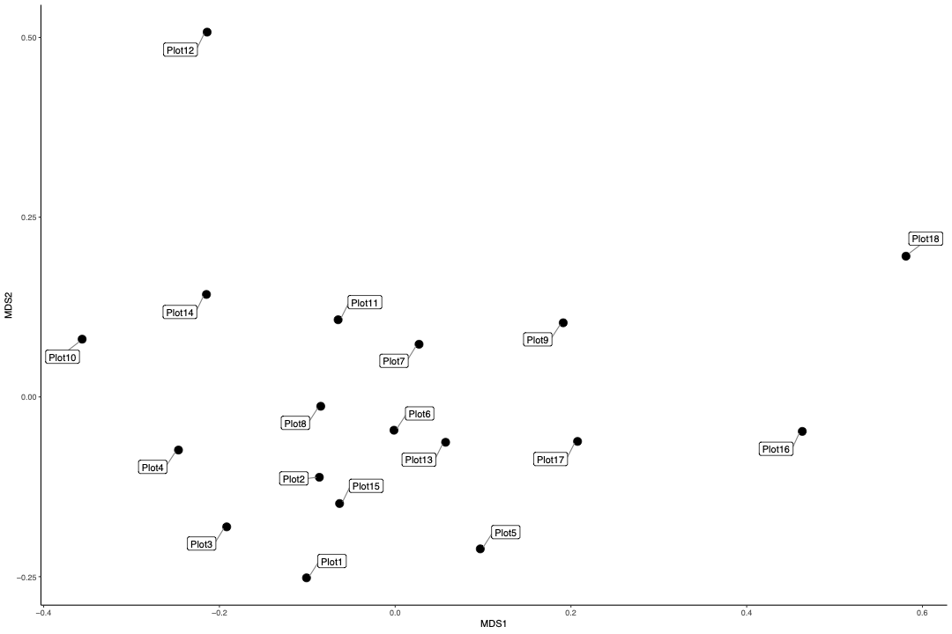
Beta Diversity
We see each plot as a community.
Plot 12, 16, 18
What features are influencing beta diversity?

Slide 21
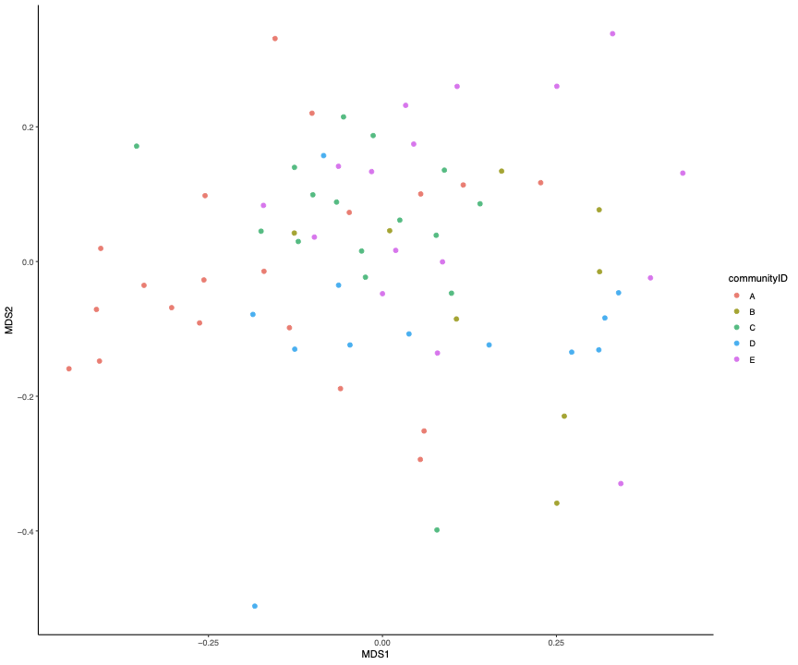
Determine the communities according to physical distance.
What features are influencing beta diversity?

Slide 22
Thanks

